Slide 1


ISDS 552 GP4
TEAM MEMBERS:
DEEPAM KHIRWAR
HARSHITA DIDWANIA
KAVINDU WALIMUNIGE
SANCHIT SINGH
SATHIYA PRIYA JEEVANANDAN

Slide 2
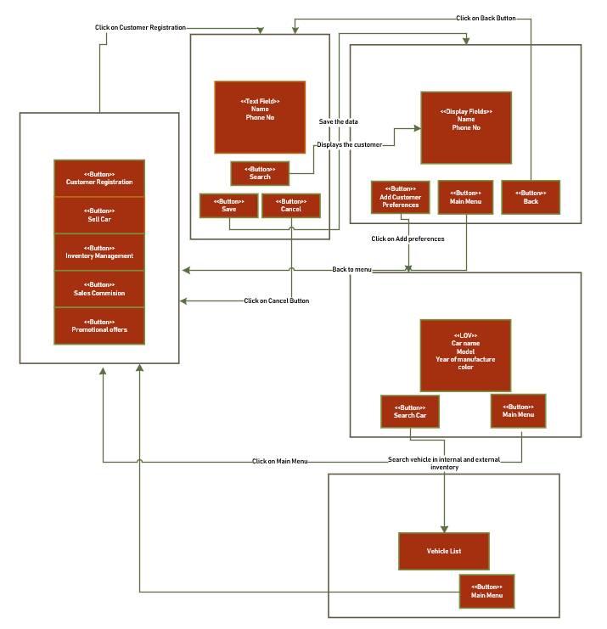
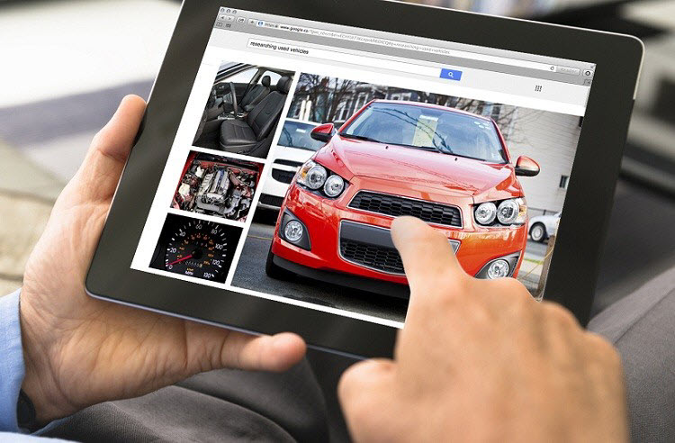
WND- Match customer with vehicles

Slide 3
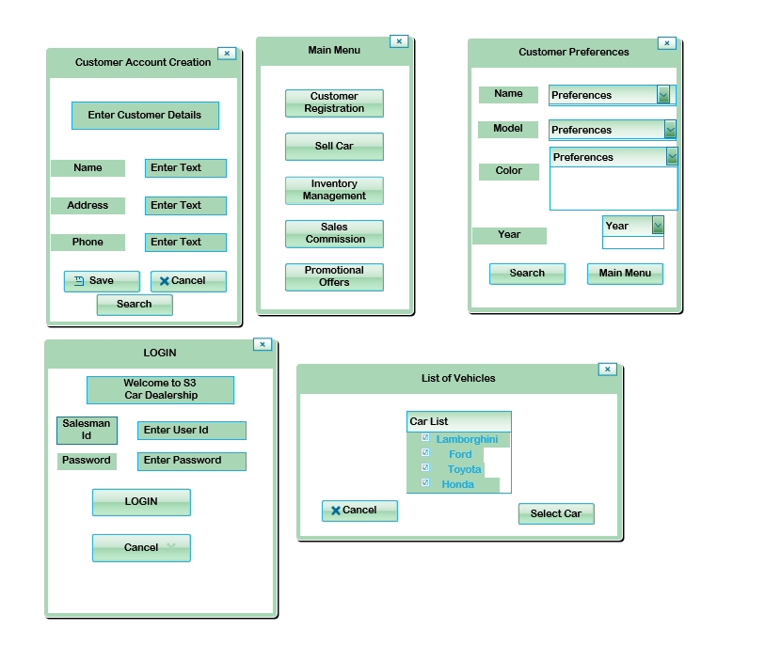
GUI- Match Customer with Vehicles

Slide 4
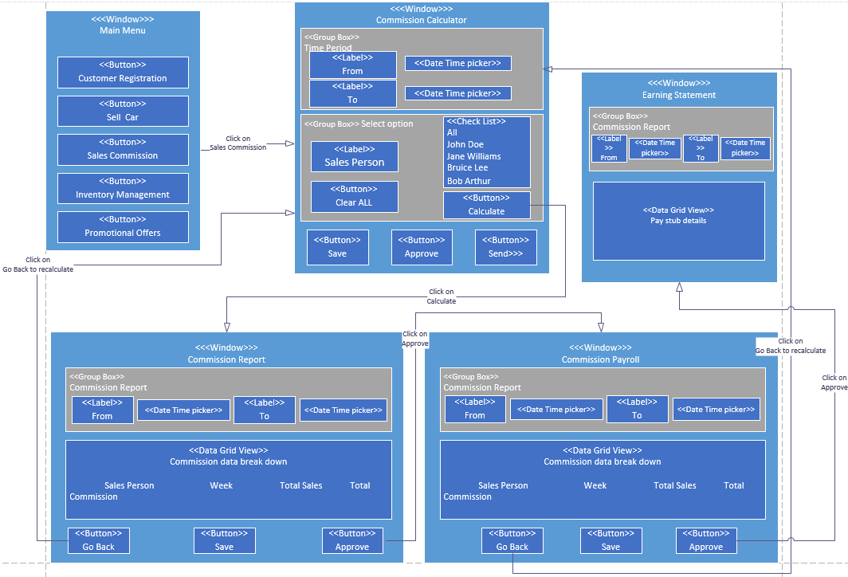


WND - Sales Commission

Slide 5
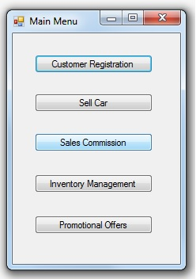
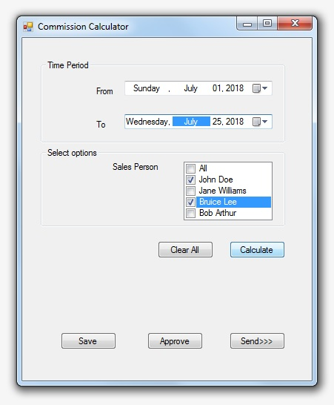
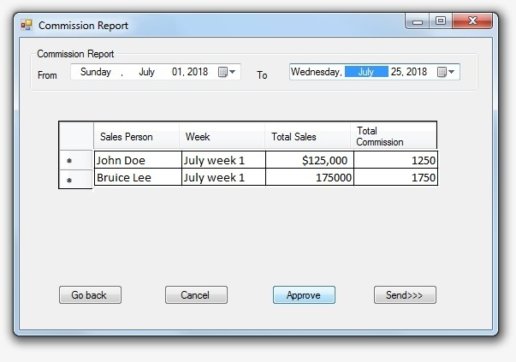
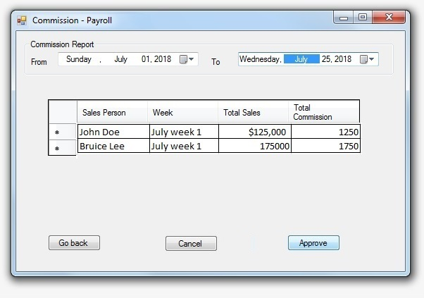
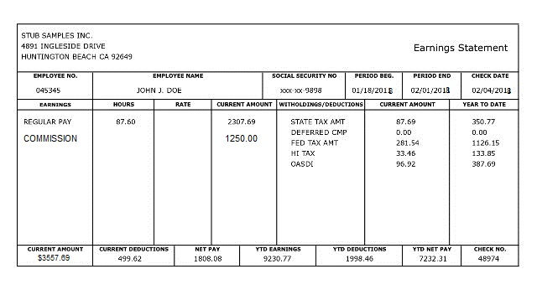
GUI - Sales Commission

Slide 6
Thank you!

